Slide 1
Project 2 - Wind Turbine Failure

Slide 2
Contents
Topic research
Business & data understanding
Data preprocessing: Exploratory data analysis (EDA), data cleaning
Data visualization, analysis with Power BI desktop
Publish reports to Power BI server, create dashboard and saved as PDF
Notes:
Change

Slide 3
Project Overview and Scope
Wind Turbine Failure:
To predict failure state of wind turbine. Predictive maintenance is used to identify pattern and fault indicators in the equipment so that failure can be predicted beforehand, thus allowing the required maintenance to be done just in time to prevent the predicted failure.
Objectives:
Minimize wind turbine unplanned failure.
Minimize wind turbine repair cost.
Maximize wind turbine service life.
Minimize wind turbine maintenance time.
Goal:
To minimize unplanned failure of wind turbine.

Slide 4
Business Problem
Wind Turbine frequent failure is causing decrease production rate of electricity and increase in maintenance cost.

Slide 5
Objective
Constraints
Minimize wind turbine unplanned failure.
Minimize wind turbine repair cost.
Maximize wind turbine service life.
Minimize wind turbine maintenance time.
Lack of newer wind turbine facilities.

Slide 6
CRISP-ML(Q) Methodology
Business Understanding and Data Understanding
Data Preparation
Data visualization, analysis with data visualization/business intelligence tool
Model Building
Evaluation
Model Deployment
Monitoring and Maintenance

Slide 7
Technical Stacks
Programming Language:
Python 3.11.5 (Spyder 5.4.3)
IPython 8.15.0
Data Manipulation Library:
Pandas (2.1.1)
Data Visualization Libraries:
Matplotlib (3.7.2)
Seaborn (0.12.2)
Automated Exploratory Data Analysis (Auto-EDA) Libraries:
SweetViz (2.2.1)
D-Tale (3.6.0)
Python Standard Library:
“os” module

Slide 8
Technical Stacks
Machine Learning Library:
scikit-learn - 1.3.0 (VarianceThreshold)
Feature Engineering Library:
feature_engine - 1.6.2 (“Winsorizer” class from “feature_engine.outliers” module)
Business Analytics Services:
Microsoft Power BI Desktop (Version: 2.123.684.0 64-bit (November 2023))
Microsoft Power BI Server
Others:
Microsoft Office 2021
Microsoft Edge
Chat GPT
draw.io
Microsoft Paint

Slide 9
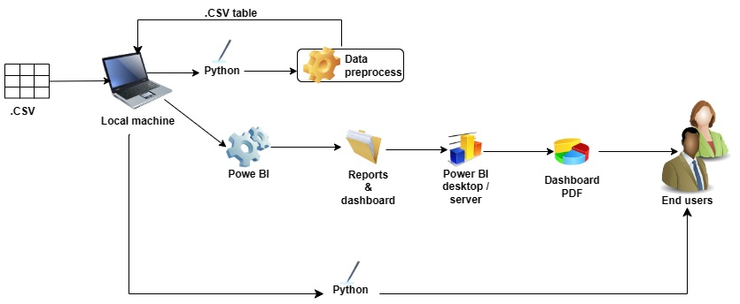
Project Architecture

Slide 10
Data Collection and Understanding
No. | Column Name | Description | Data-Type
1 | Unnamed Column | Index of the data. | Integer: quantitative, ordinal
2 | Wind_speed | The speed of the wind. | Float: quantitative, ratio
3 | Power | The power generated by the wind turbine. | Float: quantitative, ratio
4 | Nacelle_ambient_temperature | Temperature of the nacelle ambient. | Float: quantitative, interval
5 | Generator_bearing_temperature | Temperature of the generator bearing. | Float: quantitative, interval
6 | Gear_oil_temperature | Temperature of the gear oil. | Float: quantitative, interval
7 | Ambient_temperature | The ambient temperature. | Float: quantitative, interval
8 | Rotor_Speed | Speed of the rotor. | Float: quantitative, ratio
9 | Nacelle_temperature | Temperature of the nacelle. | Float: quantitative, interval
10 | Generator_speed | Speed of the generator. | Float: quantitative, ratio
11 | Yaw_angle | Yaw angle of the wind turbine. | Float: quantitative, interval
12 | Wind_direction | Direction of the wind. | Float: quantitative, interval
13 | Gear_box_inlet_temperature | Temperature of the gear box inlet. | Float: quantitative, interval
14 | Bearing_temperature | Temperature of the bearings. | Float: quantitative, interval
15 | Wheel_hub_temperature | Temperature of the wheel hub. | Float: quantitative, interval
16 | Failure_status | Indicates whether there was a failure or not. | Object: qualitative, nominal

Slide 11
System Requirements
Device Requirements:
Processor 12th Gen Intel(R) Core(TM) i3-1215U 1.20 GHz
Installed RAM 8.00 GB (7.69 GB usable)
Storage Device 256GB M.2 PCIe NVMe Solid State Drive
System type 64-bit operating system, x64-based processor
Windows Requirements:
Edition Windows 11 Home Single Language
Version 22H2
Installed on ‎6/‎18/‎2023
OS build 22621.2428
Experience Windows Feature Experience Pack 1000.22674.1000.0

Slide 12
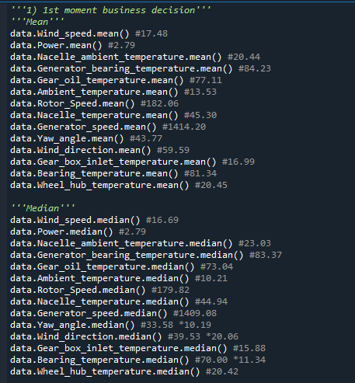
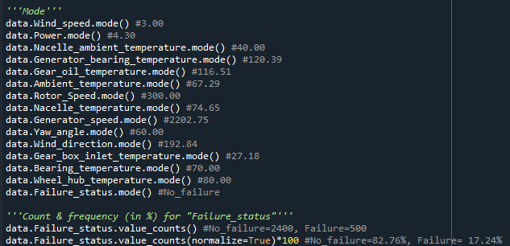
Exploratory Data Analysis [EDA]
Current wind turbine facility failure status:
No failure: 82.76%, Failure: 17.24%
Notes:
EDA is used for seeing what the data can tell us before the modeling task.
Change

Slide 13
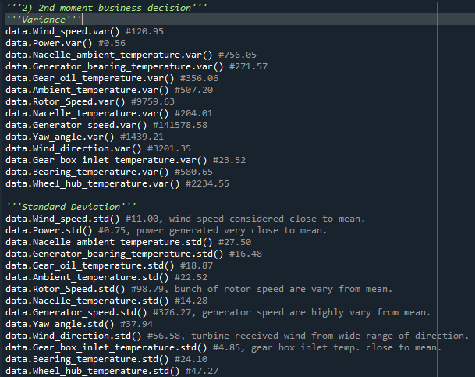
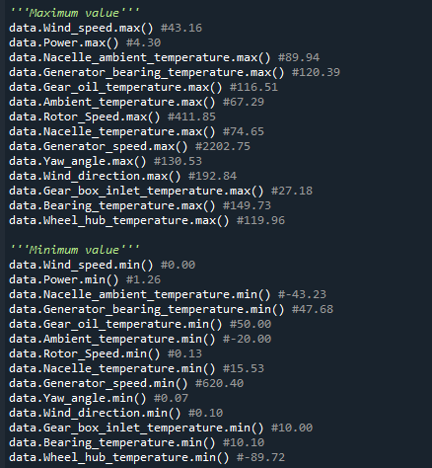
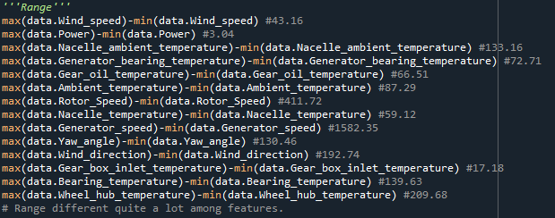
Exploratory Data Analysis [EDA]
Notes:
EDA is used for seeing what the data can tell us before the modeling task.
Change

Slide 14
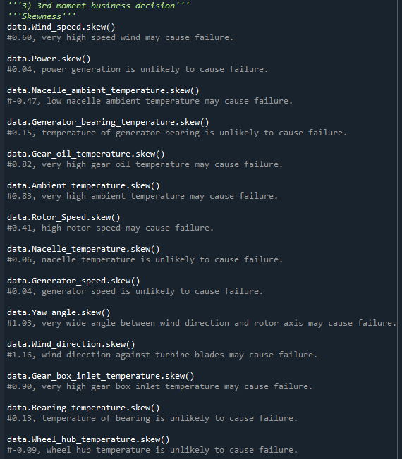
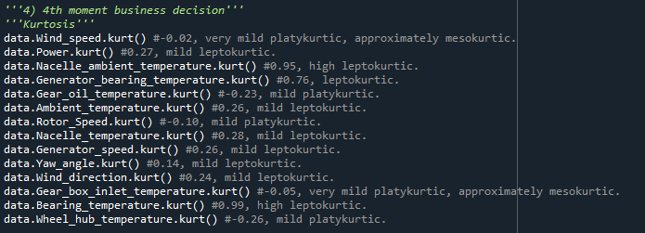
Exploratory Data Analysis [EDA]
Yaw_angle & Wind_direction are extremely positive skewed:
1.03 & 1.16 respectively.
Notes:
EDA is used for seeing what the data can tell us before the modeling task.
Change

Slide 15
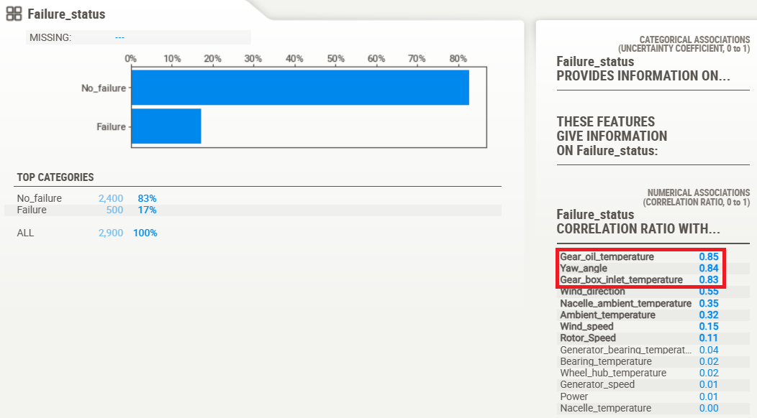
Exploratory Data Analysis [EDA]
SweetViz auto EDA giving strong correlation ratio of Gear_oil_temperature, Yaw_angle & Gear_box_inlet_temperature to Failure_status:
Suggesting these features may highly related to the failure of wind turbine.
Notes:
EDA is used for seeing what the data can tell us before the modeling task.
Change

Slide 16
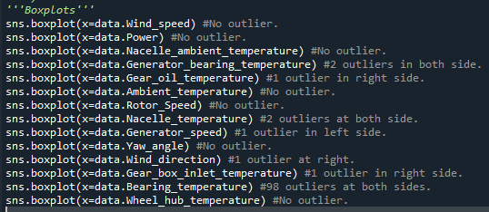
Exploratory Data Analysis [EDA]
Plotting boxplots giving 7 features are with outliers:
Generator_bearing_temperature
Gear_oil_temperature
Nacelle_temperature
Generator_speed
Wind_direction
Gear_box_inlet_temperature
Bearing_temperature
Suggesting the present of extreme values in these features.
Notes:
EDA is used for seeing what the data can tell us before the modeling task.
Change

Slide 17
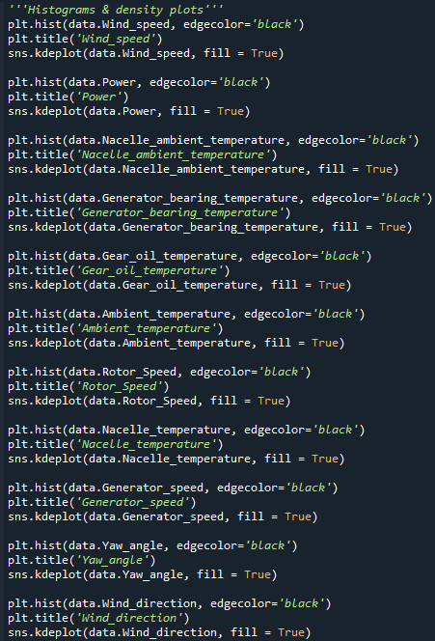
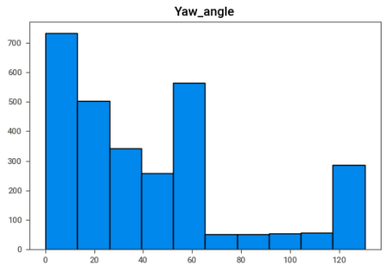
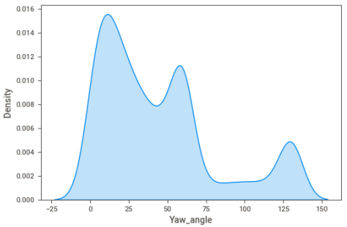
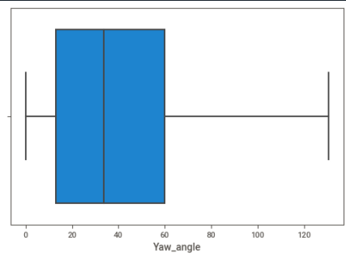
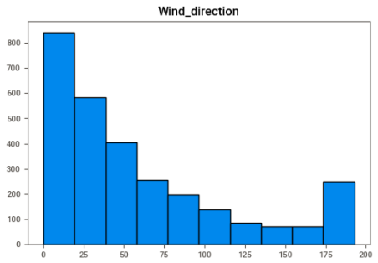
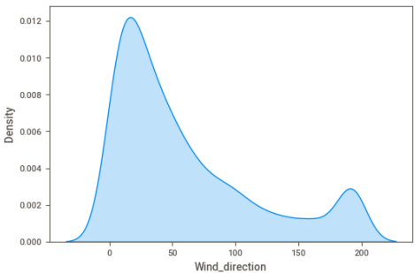
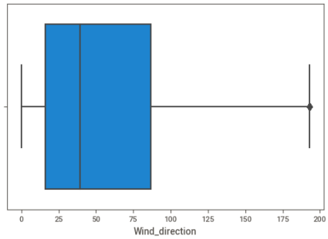
Exploratory Data Analysis [EDA]
Plots of extremely positive skewed Yaw_angle & Wind_direction features:
Both showing majority data points are concentrated at the lower scale end, with very few recorded data are larger value.
Notes:
EDA is used for seeing what the data can tell us before the modeling task.
Change

Slide 18
Exploratory Data Analysis [EDA]
EDA Conclusion:
As there are outliers & data distribution skewness in the dataset, a subsequential data cleaning is required.
Notes:
EDA is used for seeing what the data can tell us before the modeling task.
Change

Slide 19
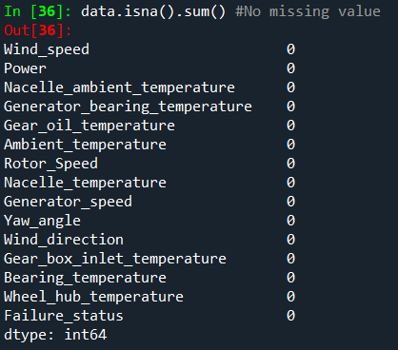
Missing Values Observation
Missing Values Conclusion:
No noticeable missing value was found in this dataset.

Slide 20
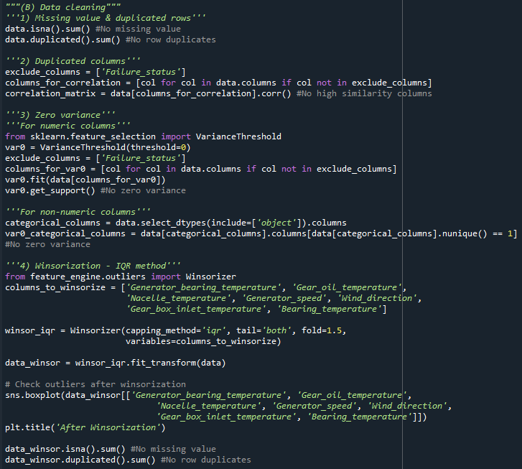
Data Cleaning
Data Cleaning Steps:
Missing value & duplicated row/column check: no missing value and duplicate found.
Zero variance check for numeric & non-numeric features: no zero variance found.
Winsorization – IQR method to handle the 7 features identified with outliers.
Data transformation was omitted even though Yaw_angle & Wind_direction are skewed:
As is to predict wind turbine failure, that is, to understand under what conditions can wind turbine fail, hence range of all features in the original dataset has to be preserved, for a later data visualization.
Observation: data transformation does impact the data range, that is, scaling it to much smaller range than its original.
Notes:
Keep observations

Slide 21
Data Visualization
Visualization Overview:
Failure_status are analyzed across all features: temperatures, speeds, wind directions & yaw angles.
Power generation are evaluated.
Wind_direction & Yaw_angle are further discretized into categories as follow for study:
(a) Wind_direction: < 90: North, < 180: East, < 270: South, < 360: West
(b) Yaw_angle: 0-60, 61-120, 121-180

Slide 22
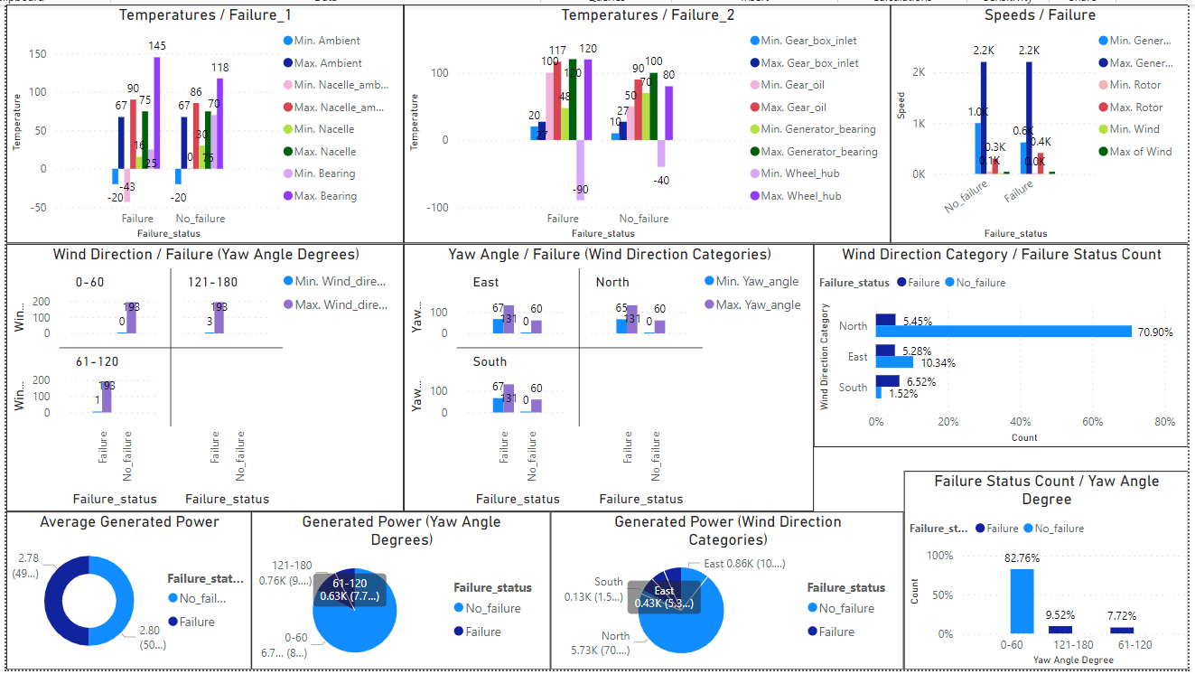
Data Visualization

Slide 23
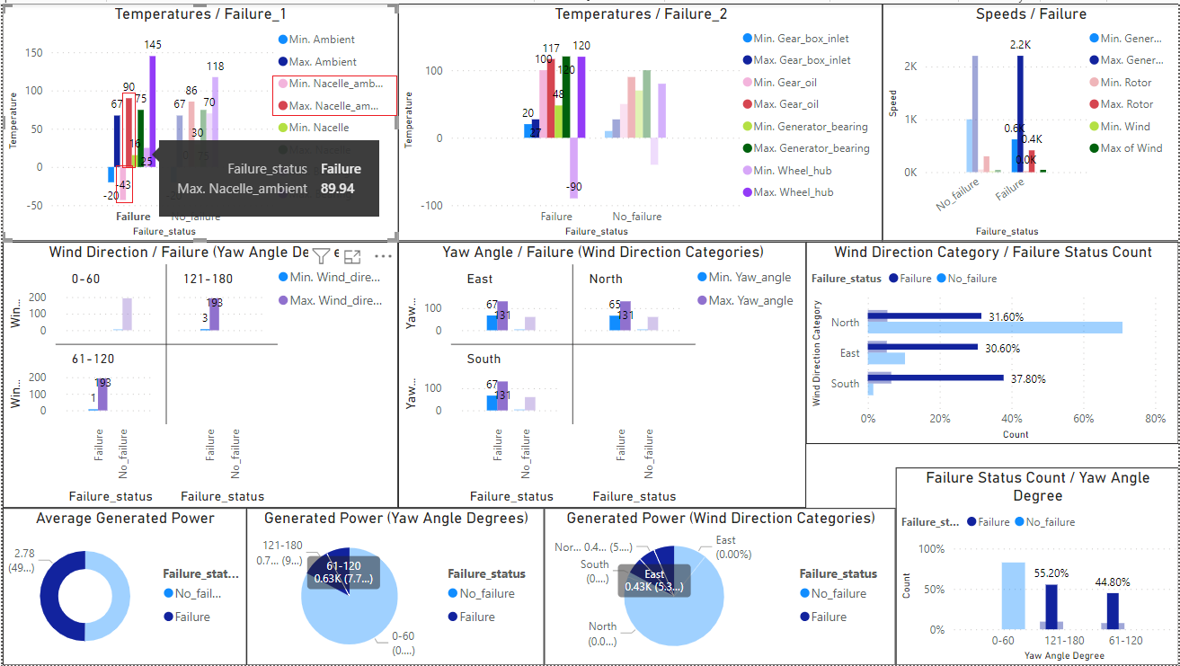
Data Visualization
Interpretation: when a single parameter & its failure status is selected, failure/non-failure conditions of other parameters will show accordingly.

Slide 24
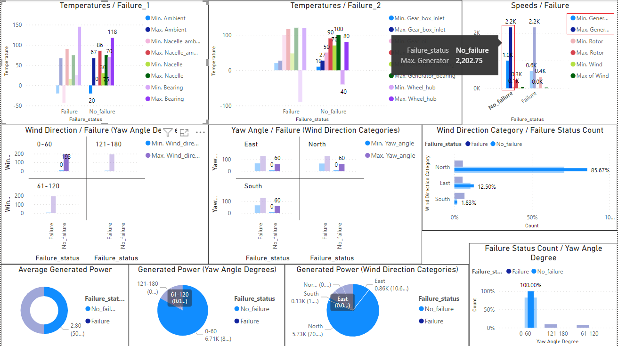
Data Visualization

Slide 25
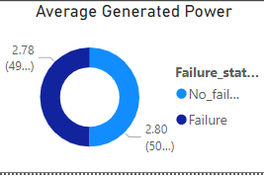
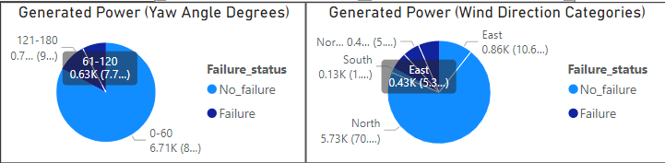
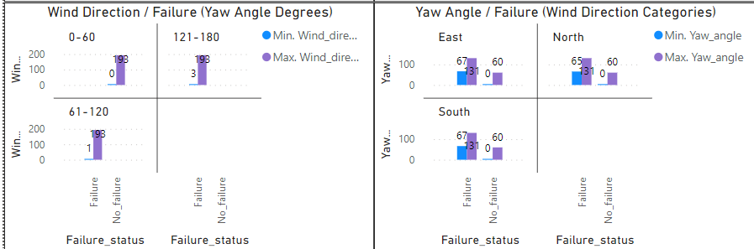
Data Visualization
Visualization Insights:
Average power generated by wind turbine failure & non-failure groups are approximately the same.
Total power generated by non-failure group are much higher, over 75%.
Wind direction alone doesn’t highly correlated to failure.
The optimum yaw angle to prevent failure is 0 -60.

Slide 26
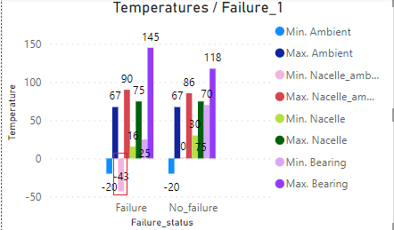
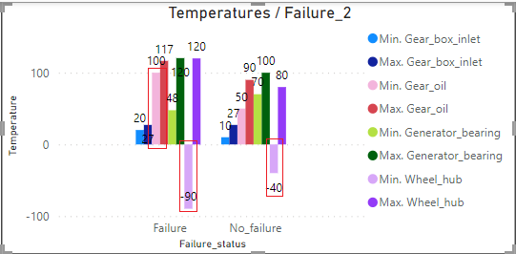
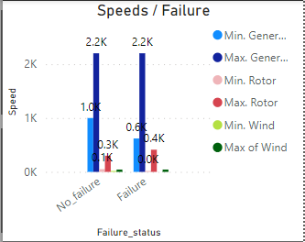
Data Visualization
Visualization Insights:
Nacelle ambient temperature < 0 possible leads to failure.
Gear oil temperature > 100 possible leads to failure.
Wheel hub temperature < -40 possible leads to failure.
Speeds & wind direction seems to relatively less correlated to temperatures in terms of wind turbine failure.

Slide 27
Future Scopes
As the current failure percentage is close to 20%, besides implementing predictive maintenance, an investment in newer wind turbine facilities may be considered.
As the average power generated by wind turbine failure & non-failure groups are approximately the same, some kind of wind turbine facility & equipment optimization is possibly needed, for greater power generation in non-failure group.

Slide 28


